Slide 1
C# for test automation
OOP basics. Classes and objects. Class string
Module 3

Slide 2
Agenda
Programming paradigms
OOP in C#. Definition
OOP. Object and classes
Class members
Fields
Constructor
Practice 1. Class members
Properties
Methods
Practice 2. Class members
Coffee break
Structure type
Limitations
Reference vs value types
Practice 3. Value vs reference types
Lunch
How to pass by reference?
Ref In Out keywords
The ref modifier
The out modifier
The in modifier
Limitations
Practice 4. Pass by reference
Coffee break
OOP. Main concepts
Encapsulation
Access modifiers
Practice 5. OOP in C#
String
String builder
String vs String builder
Practice 6. String builder
Homework

Slide 3
Object Oriented Programming In C#
Programming paradigms
Programming paradigms
Imperative
Declarative
Procedural
Functional
Object Oriented
Logical
Notes:
Programing paradigms are a way to classify programming languages based on their features
Declarative programming is a non-imperative style of programming in which programs describe their desired results without explicitly listing commands or steps that must be performed.
Functional is a programming paradigm where programs are constructed by applying and composing functions – Haskell, Swift, Scala
Logical is a is a programming paradigm which is largely based on formal logic. Any program written in a logic programming language is a set of sentences in logical form, expressing facts and rules about some problem domain which is largely based on formal logic. - Prolog
Imperative programming is a paradigm that uses statements that change the program state
Procedural Programming based upon the concept of the procedure call, simply contain a series of computational steps to be carried out.
Any given procedure might be called at any point during a program’s execution, including by other procedures or itself. Major procedural programming languages are COBOL, BASIC, C, ADA and GO
Object Oriented Programming based on the concept of objects, which contains data (attributes) and procedures (methods).
This pattern is closer to Functional Programming. Significant object-oriented languages include C++, Java, PHP, C#, Python, Ruby, Swift etc.

Slide 4
Object Oriented Programming In C#
Object oriented programming
Class
Attributes
Object
Methods
Notes:
Object-Oriented Programming (OOP) is a programming paradigm which organizes software design around objects rather than logic or function.
In general, object-oriented programming consists of objects consisting of corresponding data structures and the required procedures.
Thus, following a bottom-up problem-solving approach. It is mainly focused on data, not procedures.
In general, class is a blueprint for the object which is used to make user-defined functions.
An object is an instance of the class. Instance created according to the blueprint.
Attributes of the object store object’s data.
Methods are the procedures defined inside the body of the class. They represent the behavior of an object.

Slide 5
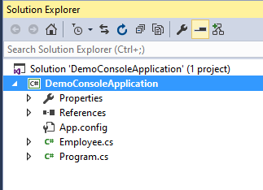
Object Oriented Programming In C#
classes
namespace DemoConsoleApplication {
class Employee {
}
}
namespace DemoConsoleApplication {
class Program {
static void Main(string[] args) {
var employee1 = new Employee();
Employee employee2 = new Employee();
}
}
}
Notes:
Typically, classes presented in project structure as .cs files.
Classes are declared using the keyword class, as shown in the example.
Although they are sometimes used interchangeably, a class and an object are different things. A class defines a type of object, but it is not an object itself:
Employee is a class
employee1 and employee2 are objects
An object is a concrete entity based on a class and is sometimes referred to as an instance of a class. Objects can be created by using the new keyword followed by the name of the class that the object will be based on.

Slide 6
Object Oriented Programming In C#
Class members
Data members
Constants - const int x = 0;
Fields - private string _name;
Function members
Methods - public override string ToString() {…}
Properties - public string Name { get; set; }
Constructors - public Employee() {…}
Finalizers - ~Employee() {…}
Operators - public static Employee operator ++(Employee emplA) {…}
Events - public event EventHandler Created;
Notes:
Classes and structs have members that represent their data and behavior. A class's members include all the members declared in the class,
along with all members (except constructors and finalizers) declared in all classes in its inheritance hierarchy.
Private members in base classes are inherited but are not accessible from derived classes.
In this module fields, constructors, properties and methods will be covered.
https://docs.microsoft.com/en-us/dotnet/csharp/programming-guide/classes-and-structs/members

Slide 7
Class members
fields
namespace DemoConsoleApplication {
class Program {
static void Main(string[] args) {
var empl = new Employee();
empl.FirstName = "John";
empl.LastName = "Doe";
Console.WriteLine(empl.FirstName
+ empl.LastName);
}
}
}
namespace DemoConsoleApplication {
public class Employee {
public string FirstName;
public string LastName;
}
}
Notes:
A field is a variable of any type that is declared directly in a class . Fields are members of their containing type.
A class may have instance fields, static fields, or both. Instance fields are specific to an instance of a type. If you have a class T, with an instance field F, you can create two objects of type T, and modify the value of F in each object without affecting the value in the other object. By contrast, a static field belongs to the class itself, and is shared among all instances of that class.
To access a field in an object, add a period after the object name, followed by the name of the field.
Fields typically store the data that must be accessible to more than one class method and must be stored for longer than the lifetime of any single method.
Variables that are not used outside the scope of a single method should be declared as local variables within the method body itself.

Slide 8
Class members
constructor
public class Employee {
public string FirstName;
public string LastName;
public Employee() { }
public Employee(string firstName) {
FirstName = firstName;
}
public Employee(string firstName,
string lastName) {
FirstName = firstName;
LastName = lastName;
}
}
namespace DemoConsoleApplication {
class Program {
static void Main(string[] args) {
Employee empl1, empl2, empl3;
empl1 = new Employee();
empl2 = new Employee("John");
empl3 = new Employee("John","Doe");
}
}
}
Notes:
A constructor is a method whose name is the same as the name of its type. Its method signature includes only the method name and its parameter list. It does not include a return type.
Whenever a class is created, its constructor is called. A class may have multiple constructors that take different arguments.
Constructors enable the programmer to set default values, limit instantiation etc
Fields are initialized immediately before the constructor for the object instance is called. If the constructor assigns the value of a field, it will overwrite any value given during field declaration.
A constructor that takes no parameters is called a parameterless constructor. Parameterless constructors are invoked whenever an object is instantiated by using the new operator and no arguments are provided to new.
If you don't provide a constructor for your class, C# creates one by default that instantiates the object and sets member variables to the default values as listed in the Default values of C# types article.
LIVE DEMO 1

Slide 9
Live demo
Initial state
static void Main(string[] args) {
var recipient = "John Doe";
var title = "Greeting";
var messageBody = "Hello John";
var signature = "Regards, John";
Console.WriteLine($"To: {recipient}");
Console.WriteLine($"Subject: {title}");
Console.WriteLine();
Console.WriteLine(messageBody);
Console.WriteLine();
Console.WriteLine(signature);
Console.ReadKey();
}
Notes:
During live demos in this module, we will refactor piece of code using our knowledge of classes.
This is starting point of our journey.

Slide 10
Live demo
Demo 1
internal class Mail {
public string Recipient;
public string Title;
public string Body;
public string Signature;
public Mail(string recipient, string title,
string body, string signature) {
Recipient = recipient;
Title = title;
Body = body;
Signature = signature;
}
}
static void Main(string[] args) {
var mail = new Mail("John Doe","Greeting",
"Hello John","Regards, John");
Console.WriteLine($"To: {mail.Recipient}");
Console.WriteLine($"Subject: {mail.Title}");
Console.WriteLine();
Console.WriteLine(mail.Body);
Console.WriteLine();
Console.WriteLine(mail.Signature);
}
Notes:
Created Mail class. The class has been used in the main method.

Slide 11
Live demo
Demo 1
internal class Mail {
public static int Count;
public string Recipient;
public string Title;
public string Body;
public string Signature;
public Mail(string recipient, string title,
string body, string signature) {
Recipient = recipient;
Title = title;
Body = body;
Signature = signature;
Interlocked.Increment(ref Count);
}
static void Main(string[] args) {
Console.WriteLine($"Count before: {Mail.Count}");
var mail = new Mail("John Doe","Greeting",
"Hello John","Regards, John");
Console.WriteLine($"Count after: {Mail.Count}");
Console.WriteLine($"To: {mail.Recipient}");
Console.WriteLine($"Subject: {mail.Title}");
Console.WriteLine();
Console.WriteLine(mail.Body);
Console.WriteLine();
Console.WriteLine(mail.Signature);
}
Notes:
Created Mail class. The class has been used in the main method.

Slide 12

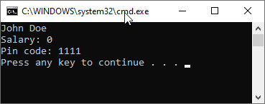
Class members
Practice 1
Create Employee class in your console application. It should have following fields:
  First name
  Last name
  Salary
  Pin code
All fields should be initialized via constructor
Write a program that will produce following output into console:

Slide 13
Class members
Practice 1 - solution
class Employee {
public string FirstName;
public string LastName;
public double Salary;
public int PinCode;
public Employee(string firstName, string lastName, double salary, int pinCode) {
FirstName = firstName;
LastName = lastName;
Salary = salary;
PinCode = pinCode;
}
}
static void Main(string[] args) {
var employee = new Employee("John","Doe",0,1111);
Console.WriteLine(($"{employee.FirstName} {employee.LastName}");
Console.WriteLine($"Salary: {employee.Salary}");
Console.WriteLine($"Pin code: {employee.PinCode}");
}

Slide 14
Class members
methods
class Employee {
public string FirstName { get; }
public string LastName { get; }
…
public string GetFullName() {
return FirstName + ' ' + LastName;
}
}
static void Main(string[] args) {
var employee = new Employee( … );
var fullName = employee.GetFullName();
Console.WriteLine(fullName);
}
Notes:
A method is a code block that contains a series of statements. A program causes the statements to be executed by calling the method and specifying any required method arguments.
Methods are declared by specifying the:
access level, such as public or private
optional modifiers, such as abstract or sealed
the return value
the name of the method
the method parameters
These parts together are the signature of the method.
Method parameters are enclosed in parentheses and are separated by commas. Empty parentheses indicate that the method requires no parameters.
Calling a method on an object is like accessing a field. After the object name, add a period, the name of the method, and parentheses.

Slide 15
Class members
properties
class Employee {
public string FirstName { get; set; }
…
}
class Employee {
…
private int _pinCode;
internal int PinCode {
get { return _pinCode; }
set { _pinCode = value; } }
…
static void Main(string[] args) {
…
employee.FirstName = "Jane";
Console.WriteLine(employee.FirstName);
…
Notes:
A property is a class member that provides a flexible mechanism to read, write, or compute the value of a private field. Properties can be used as if they are public fields, but they are actually special methods called accessors.
Properties overview
Properties enable a class to expose a public way of getting and setting values, while hiding implementation or verification code.
A get property accessor is used to return the property value, and a set property accessor is used to assign a new value. These accessors can have different access levels. For more information, see Restricting Accessor Accessibility.
The value keyword is used to define the value being assigned by the set accessor.
Properties can be:
read-write (they have both a get and a set accessor)
read-only (they have a get accessor but no set accessor)
write-only (they have a set accessor, but no get accessor)
Simple properties that require no custom accessor code can be implemented either as expression body definitions or as auto-implemented properties.
LIVE DEMO 2

Slide 16
Live demo
Demo 2
class Mail {
…
public void Send() {
Console.WriteLine($"To: {Recipient}");
Console.WriteLine($"Subject: {Title}");
Console.WriteLine();
Console.WriteLine(Body);
Console.WriteLine();
Console.WriteLine(Signature);
}
}
static void Main(string[] args) {
Mail mail = new Mail("John Doe","Greeting",
"Hello John","Regards, John");
mail.Send();
}
Notes:
Output to console moved to it’s own method

Slide 17
Class members
Practice 2
Replace fields in your class with properties. They should have only getter
Try to update property value
Create method that will return full name
Verify that program’s result is the same

Slide 18
Class members
Practice 2 - solution
public class Employee {
public string FirstName { get; }
public string LastName { get; }
public double Salary { get; }
public int PinCode { get; }
public Employee(string firstName, string lastName, double salary, int pinCode) {…}
public string GetFullName() {
return FirstName + ' ' + LastName;
}
}

Slide 19

Coffee time

Slide 20
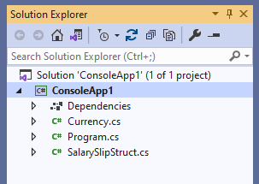
Structure types
definition
namespace DemoConsoleApplication {
struct SalarySlip {
}
}
namespace DemoConsoleApplication {
class Program {
static void Main(string[] args) {
var employee1 = new SalarySlip();
var employee2 = new SalarySlip();
}
}
}
Notes:
A structure type (or struct type) is a value type that can encapsulate data and related functionality. You use the struct keyword to define a structure type.
Structure types have value semantics. That is, a variable of a structure type contains an instance of the type. By default, variable values are copied on assignment, passing an argument to a method, and returning a method result. In the case of a structure-type variable, an instance of the type is copied.
Typically, you use structure types to design small data-centric types that provide little or no behavior. For example, .NET uses structure types to represent a number (both integer and real), a Boolean value, a Unicode character, a time instance. If you're focused on the behavior of a type, consider defining a class. Class types have reference semantics. That is, a variable of a class type contains a reference to an instance of the type, not the instance itself.

Slide 21
Structure types
Limitations
When you design a structure type, you have the same capabilities as with a class type, with the following exceptions:
You can't declare a parameterless constructor. Every structure type already provides an implicit parameterless constructor that produces the default value of the type.
You can't initialize an instance field or property at its declaration.
A constructor of a structure type must initialize all instance fields of the type.
A structure type can't inherit from other class or structure type and it can't be the base of a class. However, a structure type can implement interfaces.
You can't declare a finalizer within a structure type.

Slide 22
Reference type
example
The heap is a block of memory in which objects (i.e., reference-type instances) reside. Whenever a new object is created, it is allocated on the heap, and a reference to that object is returned.
var employee1 = new Employee(…);
Employee employee2 = new Employee(…);
object employee3 = new Employee(…);
employee1
Heap
employee2
employee3
Notes:
There are two kinds of types in C#:
reference types
value types.
Variables of reference types store references to their data (objects), while variables of value types directly contain their data.
The object of reference type is stored in the heap. You can find more by the link in the notes.
https://dev.to/tyrrrz/interview-question-heap-vs-stack-c-5aae

Slide 23
Reference type
example
var employee = new Employee(…);
Employee employee2 = employee;
In this example new Employee() statement creates one
object of type Employee in the heap.
But in variables employee and employee2 stored
reference at the same object.
employee
Heap
Notes:
With reference types, two variables can reference the same object;
therefore, operations on one variable can affect the object referenced by the other variable.
With value types, each variable has its own copy of the data, and it is not possible for operations on one variable to affect the other
Except in the case of in, ref and out parameter variables
LIVE DEMO 3

Slide 24
Live demo
Demo 3
public struct SalarySlipStruct {
public double Salary { get; }
public Currency ReportingCurrency { get; }
public float CurrencyRate { get; }
public DateTime ReportDate { get; }
public SalarySlipStruct(double salary, Currency reportingCurrency, float currencyRate) {
Salary = salary;
ReportingCurrency = reportingCurrency;
CurrencyRate = currencyRate;
ReportDate = DateTime.Today;
}
public override string ToString() => $"Salary slip:\nSalary: {Salary}\nCurrency: {ReportingCurrency}\n" +
$"Rate: {CurrencyRate}\nReport Date: {ReportDate}";
}

Slide 25
Live demo
Demo 3
static void Main(string[] args)
{
var salarySlip = new SalarySlip(1000, 50, Currency.USD,
1, 0, 0.2, 10, 20);
Console.WriteLine($"Sending salary slip: {salarySlip}");
var salarySlipStruct = new SalarySlipStruct(1000, 50, Currency.USD,
1, 0, 0.2, 10, 20);
Console.WriteLine($"\nSending salary slip (struct): {salarySlipStruct}");
Console.WriteLine("\nUpdating salary slips...\n");
DateTime reportDateTime = DateTime.Today.AddDays(-1);
UpdateClass(salarySlip, reportDateTime);
UpdateStruct(salarySlipStruct, reportDateTime);
Console.WriteLine($"Sending updated salary slip: {salarySlip}");
Console.WriteLine($"\nSending updated salary slip (struct): {salarySlipStruct}");
}
Notes:
Show difference in behaviour using UpdateClass and UpdateStruct method.

Slide 26
Live demo
Demo 3
private static void UpdateClass(SalarySlip salarySlip, DateTime dateTime) {
salarySlip.ReportDate = dateTime;
}
private static void UpdateStruct(SalarySlipStruct salarySlip, DateTime dateTime) {
salarySlip.ReportDate = dateTime;
}
Notes:
Methdos from previous slide

Slide 27

Live demo
Demo 3
Notes:
Difference in outputs

Slide 28
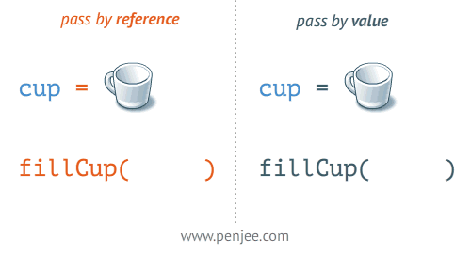
Pass by reference / value
Notes:
Link to the source of the picture
https://blog.penjee.com/passing-by-value-vs-by-reference-java-graphical/

Slide 29
Value vs reference types
Practice 3
Create a SalarySlip struct
  add few value type properties like salary, reporting date etc.
  add constructor to initialize all struct properties,
  try to add constructor with less arguments than previous one and constructor without arguments, is it possible, why?
  override the ToString method and include all the properties in it
Instantiate SalarySlip struct in the Main method and print the data into console
Create a new method of type void in the Program class that updates the SalarySlip with provided reporting date
Print the updated salary slip object from the main method to the console.
  Is the value being updated? Why?
Modify existing method to return an updated salary slip and check the console output once more
Try the same flow with SalarySlip class (Hint – change the keyword struct to class and execute the program)
  Did you get the same results in case of void method type? Why?

Slide 30
Value vs reference types
practice 3 - solution
public struct SalarySlip {
public double Salary { get; }
public DateTime ReportDate { get; set; }
public SalarySlip(double salary) {
Salary = salary;
ReportDate = DateTime.Today;
}
public override string ToString() => $"Salary slip:\nSalary: {Salary}\nReport Date: {ReportDate}";
}
private static void UpdateSalarySlip(SalarySlipStruct salarySlip, DateTime reportingDate) {
salarySlip.ReportDate = reportingDate;
}
private static void UpdateSalarySlip(SalarySlip salarySlip, DateTime reportingDate) {
salarySlip.ReportDate = reportingDate;
}

Slide 31

LUNCH

Slide 32
PASS BY reference
HOW TO PASS BY REFERENCE?
In C#, passing a Value-Type parameter to a method by value means passing a copy of the variable to the method. So, the changes made to the parameter inside the called method will not affect the original data stored in the argument variable.
private static void UpdateStruct(SalarySlipStruct salarySlip, DateTime dateTime) {
salarySlip.ReportDate = dateTime;
}
private static void UpdateStruct(ref SalarySlipStruct salarySlip, DateTime dateTime) {
salarySlip.ReportDate = dateTime;
}
Using the ref keyword, we can pass parameters by reference without copying.
Passed by value
Dealing with a copy of the value type object
Passed by reference
Dealing with the same object up the stack

Slide 33
PASS BY reference
REF IN OUT keywords
Method parameters have modifiers available to change the desired outcome of how the parameter is treated.
Each method has a specific use case:
ref
out
in
is used to state that the parameter passed may be modified by the method.
is used to state that the parameter passed must be modified by the method.
is used to state that the parameter passed cannot be modified by the method.

Slide 34
PASS BY reference
The ref Modifier
By default, a reference type passed into a method will have any changes made to its values reflected outside the method as well.
Reference type passed by value
private static void UpdateSalarySlip(SalarySlip salarySlip, DateTime reportingDate) {
salarySlip.ReportDate = reportingDate;
}
Reference type represents the same object stored in the heap and accessed by a reference
Where reference is passed to method by value
This change will be visible outside of the method

Slide 35
PASS BY reference
The ref Modifier
If you assign the reference type to a new reference type inside the method, those changes will only be local to the method.
Using the ref modifier, you have the option to assign a new reference type and have it reflected outside the method.
private static void UpdateSalarySlip(SalarySlip salarySlip, DateTime reportingDate) {
// …
salarySlip = new SalarySlip();
}
Local variable which exists only in the current stack frame
This assignment will be lost after the method finishes executing.

Slide 36
PASS BY reference
The ref Modifier
Using the ref modifier, you have the option to assign a new reference type and have it reflected outside the method.
Reference type passed by reference
private static void UpdateSalarySlip(ref SalarySlip salarySlip, DateTime reportingDate) {
// …
salarySlip = new SalarySlip();
}
This variable represents reference to variable outside of the method
This assignment will be visible after the method finishes executing

Slide 37
PASS BY reference
The OUT Modifier
Using the out modifier, we initialize a variable inside the method. Like ref, anything that happens in the method alters the variable outside the method.
With ref, you have the choice to not make changes to the parameter.
bool ValidateSalarySlip(SalarySlip salarySlip, out string validationMessage) {
if (Math.Abs(salarySlip.Salary - default(double)) < double.Epsilon
&& salarySlip.WorkedDays > 0) {
validationMessage = "The correct salary value is missing.";
return false;
}
//other validations...
validationMessage = string.Empty;
return true;
}
When using out, you must initialize the parameter you pass inside the method.

Slide 38
PASS BY reference
The IN Modifier
The in modifier is most often used for performance reasons and was introduced in C# 7.2.
The motivation of in is to be used with a struct to improve performance by declaring that the value will not be modified.
When using with reference types, it only prevents you from assigning a new reference.
Value type passed by reference, additional memory in the stack is not allocated
private static void SendSalarySlip(in SalarySlipStruct salarySlip) {
// …
}
Reference type passed by reference
private static void UpdateSalarySlip(in SalarySlip salarySlip) {
salarySlip = new SalarySlip();
}
Compile error

Slide 39
PASS BY reference
LIMITATIONS
When overloading a method in C#, using a modifier will be considered a different method signature than not using a modifier at all. You cannot overload a method if the only difference between methods is the type of modifier used. This will result in a compile error.
It's important to note that in, out, and ref cannot be used in methods with the async modifier. You can use them in synchronous methods that return a task, though.
Pass a struct as the argument for an in parameter only if it's declared with the readonly modifier or the method accesses only readonly members of the struct. Otherwise, the compiler must create defensive copies in many situations to ensure that arguments are not mutated.

Slide 40
PASS BY reference
Practice 4
Modify UpdateSalarySlip method that does not return a value by providing ref keyword for struct SalarySlip
Verify that changes made inside the method are visible outside of the method
Change ref keyword to out. Is it valid for this example? Why?

Slide 41
PASS BY reference
practice 4 - solution
internal struct SalarySlip {
public double Salary { get; }
public DateTime ReportDate { get; set; }
public SalarySlip(double salary) {
Salary = salary;
ReportDate = DateTime.Today;
}
public override string ToString() => $"Salary slip:\nSalary: {Salary}\nReport Date: {ReportDate}";
}
private static void UpdateSalarySlip(ref SalarySlipStruct salarySlip, DateTime reportingDate) {
salarySlip.ReportDate = reportingDate;
}

Slide 42
Coffee time

Slide 43
Object Oriented Programming In C#
four main concepts (A-PIE)
Polymorphism
Static
Dynamic
Inheritance
Parent child concept
Hierarchical
Types of inheritance
OOP concepts
Encapsulation
Class or Interface
Access Modifiers
Abstraction
Abstract Class
Abstract Method
Interface
Notes:
C# provides a full support for object-oriented programming concepts including encapsulation, inheritance and polymorphism.
In this module only Encapsulation will be covered.

Slide 44
Object Oriented Programming In C#
Encapsulation EXAMPLE
internal class Employee {
public string Name { get; }
public double Salary { get; }
private int _pinCode;
internal Employee(string name, int salary) {
Name = name;
Salary = salary;
}
}
Encapsulated data
Encapsulation unit
Notes:
Encapsulation means that a group of related methods, properties, and other members is treated as a single physical or logical package.
In c#, Encapsulation is a process of binding the data members and member functions into a single unit. In c#, the class is the real-time example for encapsulation because it will combine various types of data members and member functions into a single unit.
In this example Employee class is encapsulation unit which describes Employee package.
Class Employee has two readonly properties - Salary and Name which can be assigned only from constructor. That means that no one can modify these properties from outside.

Slide 45
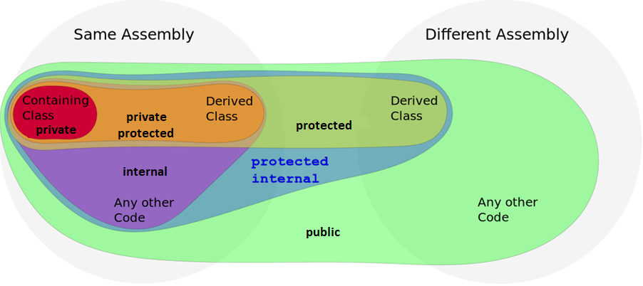
Object Oriented Programming In C#
Encapsulation
Notes:
Encapsulation is implemented by using access specifiers. An access specifier defines the scope and visibility of a class member. C# supports the following access specifiers:
All types and type members have an accessibility level. The accessibility level controls whether they can be used from other code in your assembly or other assemblies. Use the following access modifiers to specify the accessibility of a type or member when you declare it:
public: The type or member can be accessed by any other code in the same assembly or another assembly that references it.
private: The type or member can be accessed only by code in the same class or struct.
protected: The type or member can be accessed only by code in the same class, or in a class that is derived from that class.
internal: The type or member can be accessed by any code in the same assembly, but not from another assembly.
protected internal: The type or member can be accessed by any code in the assembly in which it's declared, or from within a derived class in another assembly.
private protected: The type or member can be accessed only within its declaring assembly, by code in the same class or in a type that is derived from that class.

Slide 46
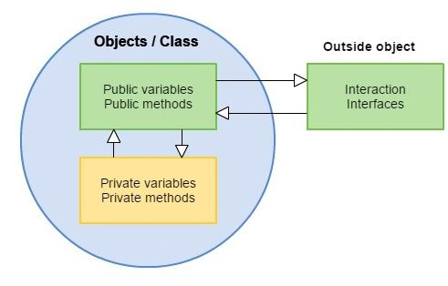
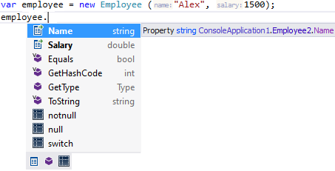
Object Oriented Programming In C#
Encapsulation
Only public properties are
available from outside of the object
private field - _pinCode is not visible
Notes:
Encapsulation, in the context of C#, refers to an object's ability to hide data and behavior that are not necessary to its user. Encapsulation enables a group of properties, methods and other members to be considered a single unit or object.
Encapsulation is used to restrict access to the members of a class to prevent the user of a given class from manipulating objects in ways that are not intended by the designer.

Slide 47
Default access modifiers
Default access modifiers at Namespace level are internal. Classes and structs are declared directly within a namespace (in other words, they aren't nested within other classes or structs)
Default access modifiers at Class level are private. Class and struct members, including nested classes and structs.
Default access modifiers at function level are private; we are not allowed to use even private keywords explicitly.
Other types

Slide 48
Object Oriented Programming In C#
Encapsulation
The following are the benefits of encapsulation:
Reduces complexity
Structural changes remain local
Easier maintenance
Notes:
LIVE DEMO 4

Slide 49


Live demo
Demo 4
Notes:
Add new project – ExternalService

Slide 50
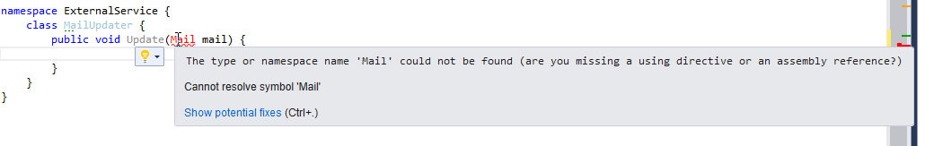
Live demo
Demo 4
Notes:
Create new class in the new project. Try to instantiate Mail class in it.
It shouldn’t be possible at the moment because Mail class is internal at the moment

Slide 51
Live demo
Demo 4
public class Mail {
internal string Recipient;
internal string Title;
internal string Body;
internal string Signature;
public Mail(string recipient, string title, string body, string signature) {…}
public void Send() {…}
}
Notes:
Make Mail class public

Slide 52
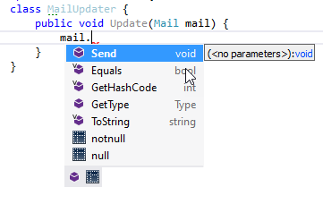
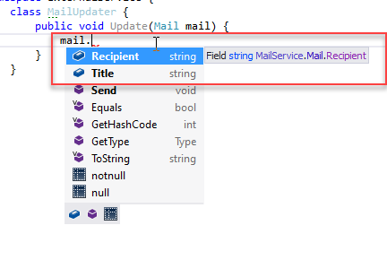
Live demo
Demo 4
public class Mail {
public string Recipient;
public string Title;
internal string Body;
internal string Signature;
public Mail(string recipient, string title,
string body, string signature) {…}
public void Send() {…}
}
Notes:
Only public members are visible from the outside of the project.

Slide 53
Object Oriented Programming In C#
Practice 5
Add new project to solution
Transfer Employee and SalarySlip classes/structs into the new project
Add needed references
Set access modifiers as restrictive as possible
Verify that your program is still working as intended
Explore how class members accessibility changed
Convert private properties to private fields

Slide 54
Object Oriented Programming In C#
Practice 5 - solution
public class Employee {
private string _firstName;
private string _lastName;
private double _salary;
private int _pinCode;
public Employee(…) {
_firstName = firstName;
_lastName = lastName;
_salary = salary;
_pinCode = pinCode;
}
private string GetFullName() {
return _firstName + " " + _lastName;
}
}
public struct SalarySlip {
private double Salary;
public DateTime ReportDate { get; set; }
public SalarySlip(double salary) {
_salary = salary;
ReportDate = DateTime.Today;
}
public override string ToString() => $"Salary slip:\nSalary: {_salary}\nReport Date: {ReportDate}";
}

Slide 55
Coffee time

Slide 56
string
How to create a string
By assigning a string literal to a String variable.
string myString = "This is a string created by assignment.";
By calling a String class constructor.
string myString = new string('c', 20);
By using the string concatenation operator
string myString = "This is one sentence. " + "This is a second. ";
By retrieving a property or calling a method that returns a string
employee.FirstName
By calling a formatting method to convert a value or object to its string representation.
int one = 1;
one.ToString()
Examples
Notes:
LIVE DEMO 5

Slide 57
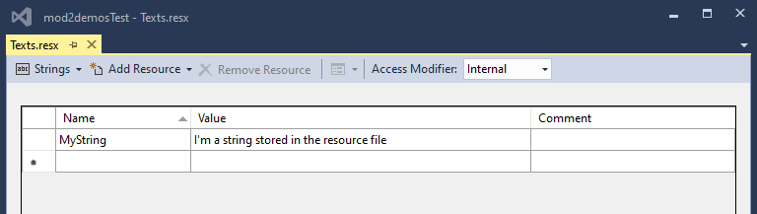
Live demo
Demo 5
static void Main(string[] args) {
Console.WriteLine(Texts.MyString);
}

Slide 58
string
What is a string
namespace System {
//
// Summary:
// Represents text as a series of Unicode characters. To browse the .NET Framework
// source code for this type, see the Reference Source.
[ComVisible(true)]
[DefaultMember("Chars")]
public sealed class String : IComparable, ICloneable, IConvertible, IEnumerable, IComparable<String>, IEnumerable<char>, IEquatable<String> {
public static readonly String Empty;
public String(char[] value);
public String(sbyte* value);
public String(char* value);
public String(char c, int count);
public String(char[] value, int startIndex, int length);
public String(sbyte* value, int startIndex, int length);
public String(char* value, int startIndex, int length);
public String(sbyte* value, int startIndex, int length, Encoding enc);
…
Notes:
A string is a sequential collection of characters that is used to represent text. A String object is a sequential collection of System.Char objects that represent a string
The string is immutable (that is, it is read-only).
If you edit a string, you are really not modifying that string; rather, the CLR is creating a new memory reference for the modified string, and the original string will get removed from memory via garbage collection.
Pros
One advantage is that they are thread safe. If you are working with a multi threaded system, there will be no risk of a deadlock or any concurrency issues, since when you modify a string, you are really just creating a new object in memory.
Another advantage is that you will not have to worry about accidentally changing them. You do not need to take the additional safety measures (i.e. a defensive object copy) that you may need to take with a mutable object.
Cons
Why are immutable strings a bad idea? The main issue is that constantly changing strings can lead to performance issues.

Slide 59
String builder
What is a string builder
namespace System.Text {
//
// Summary:
// Represents a mutable string of characters. This class cannot be inherited.To
// browse the .NET Framework source code for this type, see the Reference Source.
public sealed class StringBuilder : ISerializable {
public StringBuilder();
public StringBuilder(int capacity);
public StringBuilder(string value);
public StringBuilder(string value, int capacity);
public StringBuilder(int capacity, int maxCapacity);
public StringBuilder(string value, int startIndex, int length, int capacity);
…
Notes:
Represents a mutable string of characters.
Although StringBuilder and String both represent sequences of characters, they are implemented differently. String is an immutable type. That is, each operation that appears to modify a String object actually creates a new string.
For routines that perform extensive string manipulation (such as apps that modify a string numerous times in a loop), modifying a string repeatedly can exact a significant performance penalty. The alternative is to use StringBuilder, which is a mutable string class.
Mutability means that once an instance of the class has been created, it can be modified by appending, removing, replacing, or inserting characters. A StringBuilder object maintains a buffer to accommodate expansions to the string. New data is appended to the buffer if room is available; otherwise, a new, larger buffer is allocated, data from the original buffer is copied to the new buffer, and the new data is then appended to the new buffer.
Although the StringBuilder class generally offers better performance than the String class, you should not automatically replace String with StringBuilder whenever you want to manipulate strings. Performance depends on the size of the string, the amount of memory to be allocated for the new string, the system on which your app is executing, and the type of operation. You should be prepared to test your app to determine whether StringBuilder actually offers a significant performance improvement.

Slide 60
String builder
When to use
Consider using the String class under these conditions:
When the number of changes that your app will make to a string is small.
When you are performing a fixed number of concatenation operations, particularly with string literals.
When you must perform extensive search operations while building your string. The StringBuilder class lacks search methods such as IndexOf or StartsWith. You'll have to convert the StringBuilder object to a String for these operations, and this can negate the performance benefit from using StringBuilder.
Consider using the StringBuilder class under these conditions:
When you expect your app to make an unknown number of changes to a string at design time
When you expect your app to make a significant number of changes to a string.

Slide 61
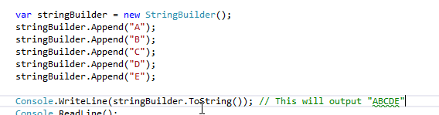
String builder
Usage example
Notes:
LIVE DEMO 6

Slide 62
Live demo
Demo 6
public class Mail {
internal string Body { get { return bodyBuilder.ToString(); } }
private StringBuilder bodyBuilder;
public Mail(string recipient, string title, string body, string signature) {
Recipient = recipient;
Title = title;
Signature = signature;
bodyBuilder = new StringBuilder(body);
}
public void Send() {…}
public void AppendMessage(string additionalMessage) {
bodyBuilder.Append(additionalMessage);
}
}
Notes:
As we don’t know how many times we would like to increase Body, we are going to use StringBuilder

Slide 63
Live demo
Demo 6
static void Main(string[] args) {
…
Console.WriteLine("\nAppending message in the mail...");
mail.AppendMessage("\n...Additional text ...");
mail.Send();
}

Slide 64
String builder
Heap
String vs string builder
Hello! This is C# course
string testString = "Hello!";
testString = testString + " This";
testString = testString + " is";
testString = testString + " C#";
testString = testString + " course";
Hello! This
Hello! This is
Hello! This is C#
Hello!
This
Is
C#
course
StringBuilder stringBuilder = new StringBuilder();
stringBuilder.Append("Hello!");
stringBuilder.Append(" This");
stringBuilder.Append(" is");
stringBuilder.Append(" C#");
stringBuilder.Append(" course");
string testString = stringBuilder.ToString();
Heap
Hello! This is C# course
Hello!
This
Is
C#
course
Notes:
LIVE DEMO 6

Slide 65
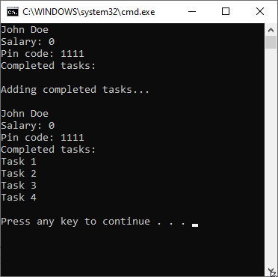
String builder
Practice 6
Add private field of type StringBuilder to your Employee class. Name it - completedTasks
Add new method AddCompletedTask. The method should accept name of the task as an argument
Employee description should contain list of completed tasks
Update your program to produce following output:

Slide 66
String builder
Practice 6 - solution
public class Employee {
…
private StringBuilder completedTasks;
public Employee(string firstName, string lastName, double salary, int pinCode) {
…
completedTasks = new StringBuilder();
}
…
public void AddCompletedTask(string taskName) {
completedTasks.AppendLine(taskName);
}
public void Describe() {
…
Console.WriteLine("Completed tasks:");
Console.WriteLine(completedTasks.ToString());
}

Slide 67
String builder
Practice 6 - solution
static void Main(string[] args) {
var employee = new Employee("John","Doe",0,1111);
employee.Describe();
Console.WriteLine("Adding completed tasks...");
employee.AddCompletedTask("Task 1");
employee.AddCompletedTask("Task 2");
employee.AddCompletedTask("Task 3");
employee.AddCompletedTask("Task 4");
Console.WriteLine();
employee.Describe();
}

Slide 68
homework

